Slide 1

Summer Internship 2016
Mentored by – Dr. Amit Chattopadhyay
Contour Tree
Presented by :-
Samarth Mishra
x---Date---x

Slide 2
Introduction
Many imaging technologies and scientic simulations produce data in the form of sample points with intensity Values.
Contour trees were proposed by van Kreveld et al for computing isolines on terrain maps in geographic information systems.
With terrain maps, a surface model is computed from elevation values at sample points in the plane.
Contours can be traced from a surface model relatively easily, given a starting point

Slide 3
Definition
The contour tree for a Morse function is defined as a graph in which:
each leaf vertex represents the creation or deletion of a component at a local extremum of the parameter
each interior vertex represents the joining and/or
splitting of two or more components at a critical point.
each edge represents a component in the level sets for all values of the parameter between the values
of the data points at each end of the edge.

Slide 4
Morse Theory
-> Morse theory studies the changes in topology of level sets of f as the parameter x changes. Points at which the topology of the level sets change are called critical points.
-> Morse theory requires that the critical points be isolated – i.e. that they occur at distinct points and values.
-> A function that satisfies this condition is called a Morse function. All points other than critical points are called regular points

Slide 5
Abstract
The Contour Tree is a data structure that represents the relations between the connected components of the level sets in a scalar field.
Two connected components that merge together (as one continuously changes the isovalue) are represented as two arcs that join at a node of the tree.
The first efficient technique for Contour Tree computation in 2D was introduced by de Berg and van Kreveld. O(n log n)
Recently Carr,Snoeyink and Axen presented an elegant extension to any di-mension based on a two-pass scheme that builds a Join Tree and a Split Tree that are merged into a unique Contour Tree. O(m + n log n)

Slide 6
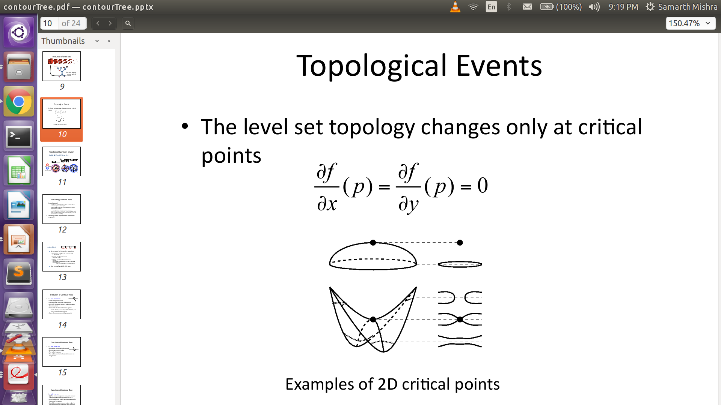
Critical Points and Topology
The points where the topology of the contour changes are called critical points.

Slide 7
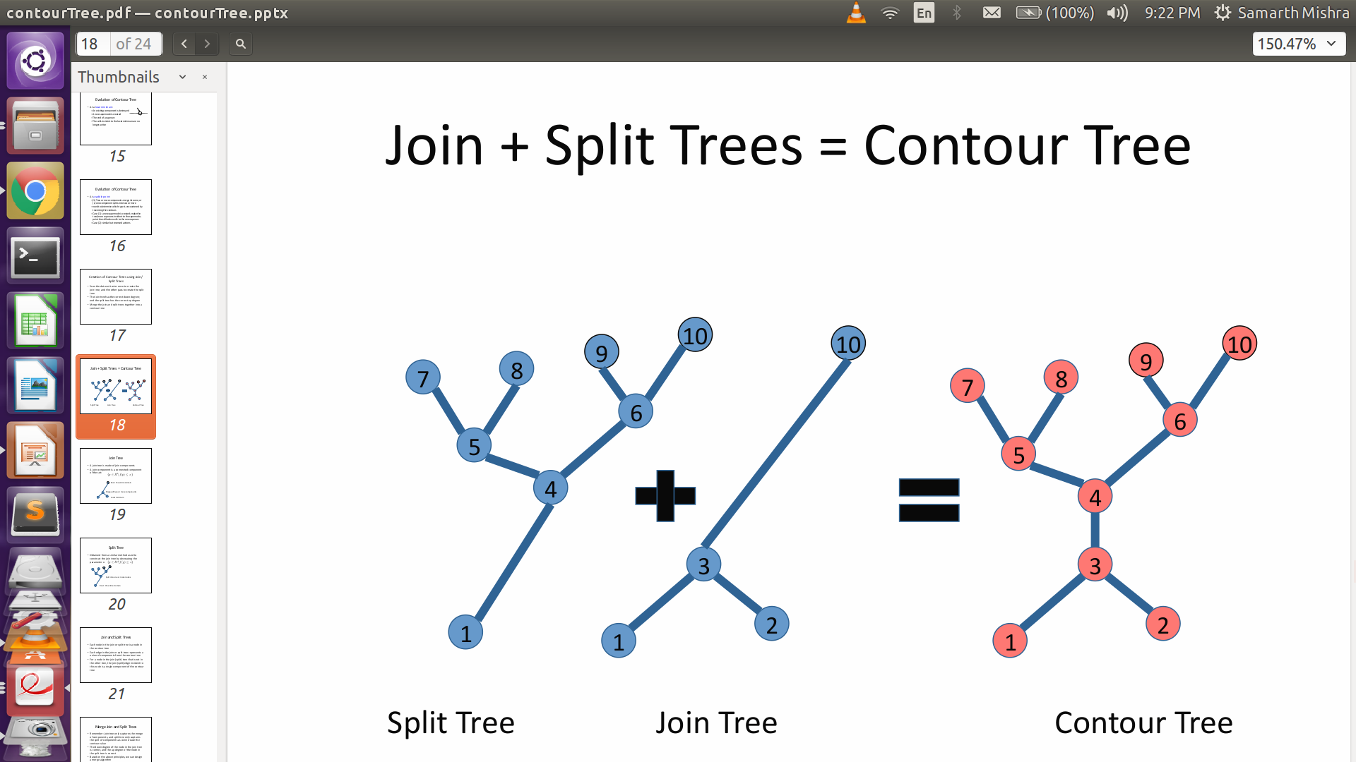
Contour Tree

Slide 8
Stages of the Algorithm
Sorting of the vertices in the field
Computing the Join Tree
Computing the Split Tree
Merging the Join Tree and Split Tree to build the Contour Tree

Slide 9
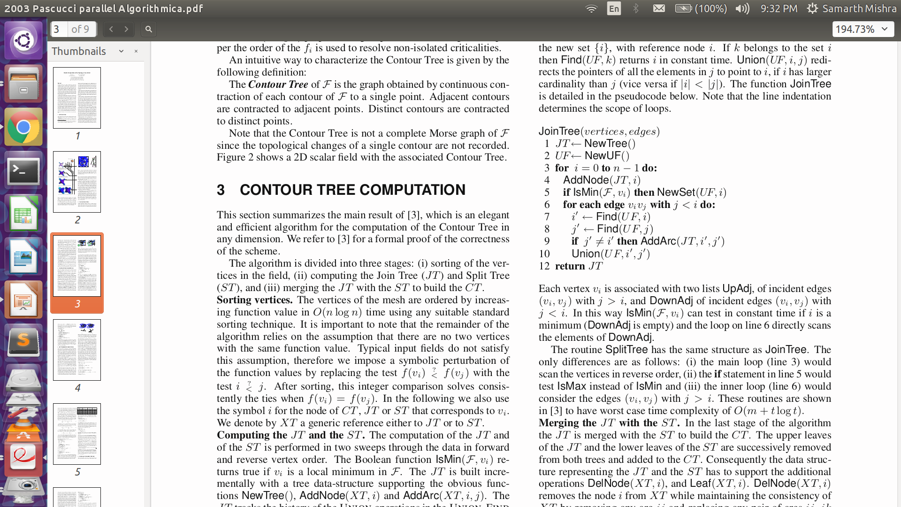
Join Tree
JT is the Join Tree with NewTree() function initializing it.
UF is the union-find Data Structure with NewUF() initializing it.
AddNode(JT,i) adds a new node i to JT.
IsMin(F,v_{i}) checks whether the vertex is a minimum. If true then it is added to a new set in UF by NewSet(UF,i) function.
Find(UF,i) checks if the element is present in any of the set in UF. If true then it returns the representative element of the set.
AddArc(JT,i',j') adds an edge between the element i' and j'.
Union(UF,i',j') merges the set containing i' and j' and makes a new representative element.

Slide 10
Split Tree
the main loop (line 3) would scan the vertices in reverse order
the if statement in line 5 would test IsMax instead of IsMin
the inner loop (line 6) would consider the edges (v_{i} , v_{j} ) with j > i.

Slide 11
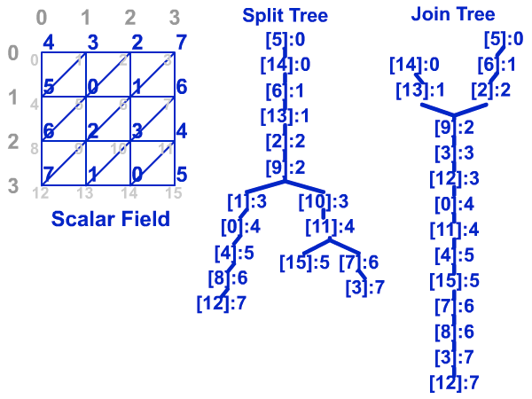
Example
Let us consider a scalar field :

Slide 12
Sorted Values
Vertex
5 | 14 | 6 | 13 | 2 | 9 | 1 | 10 | 0 | 11 | 4 | 15 | 7 | 8 | 3 | 12
0 | 0 | 1 | 1 | 1 | 2 | 3 | 3 | 4 | 4 | 5 | 5 | 6 | 6 | 7 | 7
Values
Note : If f_{i} = f_{j} then in the case of ascending sorting i will lie before j if i<j

Slide 13
Join Tree
JT
UF
5
[ {5*} ]
5
[ {5*} {14*} ]
14
5
[ {5,6*} {14*} ]
14
6
5
14
6
[ {5,6*} {14,13*} ]
13
And So on ....for Join tree and the Split tree is created with the modifications as mentioned before.

Slide 14

Formation of Split Tree and Join Tree

Slide 15
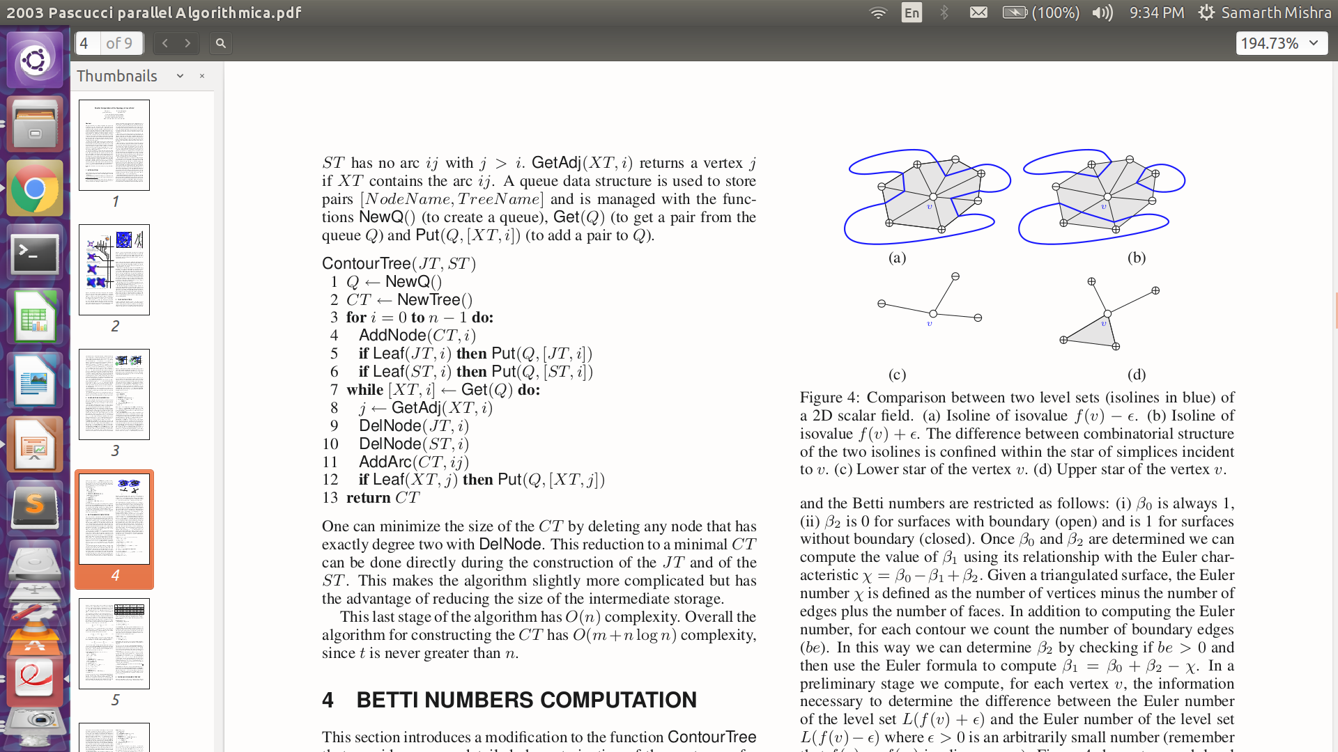
Contour Tree
JT is the Join Tree ST is Split Tree.
Q is Queue Data Structure with NewQ() inititalizing it.
CT is Contour Tree with NewTree() inititalizing it.
AddNode(CT,i) adds the node i to CT.
Leaf(XT,i) checks if i is a node in XT {XT : JT/ST}.
Put(Q,[XT,i]) adds the node i to Q also adding the information about which tree XT {JT/ST}.
Get(Q) pushes the elements out of Q getting node i and tree XT.
GetAdj(XT,i) will give the information about the adjacent node to i in XT and store it in j.
DelNode(JT,i) and DelNode(ST,i) deletes the node i in JT and ST respectively.
AddArc(CT,ij) adds an edge between i and j in CT.

